Slide 1



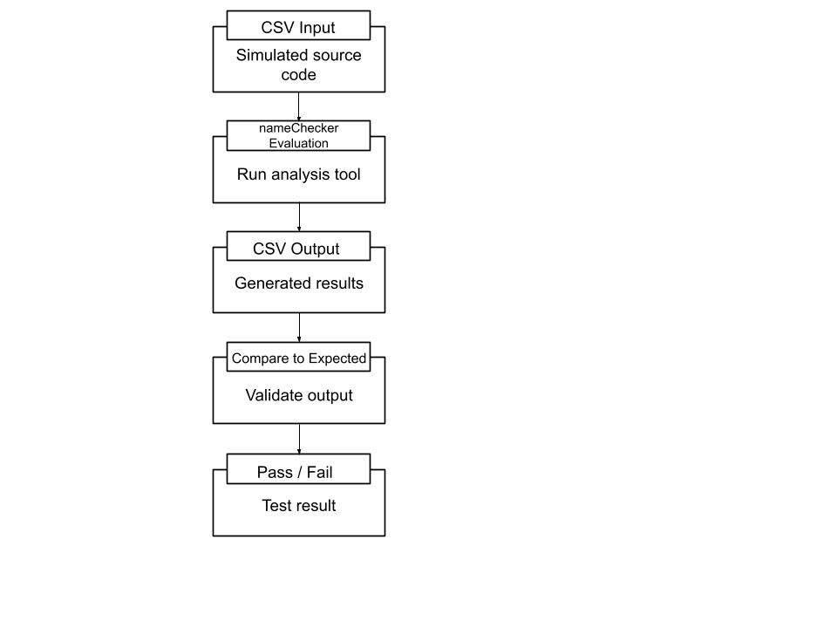
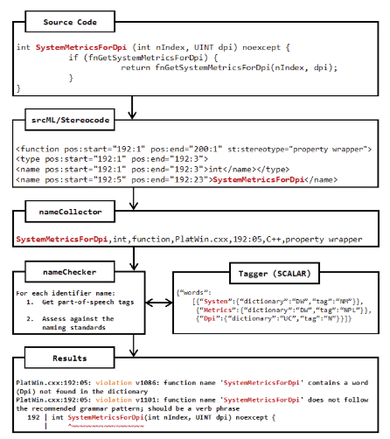
nameChecker: Testing and Validation of a Naming Convention Enforcement Tool
Paige Ogden
KSU Department of Computer Science
Research Advisor:
Jonathan I. Maletic, Ph.D.
Motivation
Test Setup
Good identifier names in source code help ensure readable and maintainable code
The goal is to test and validate nameChecker, a tool that enforces naming conventions
The test suite developed enforces the twelve class naming standards
Tests ensure consistency and accuracy of the program to enforce the defined standards
No Violation Example
Create CSV input:
test_class.csv
Vector,,class,...
Execute nameChecker program:
nameChecker -i test_class.csv
-o test_class_output.csv
Compare to expected output
Expected=""
What is nameChecker?
An automated tool to enforce identifier naming standards
Analyzes source code and reports violations
Reports violations similar to standard compiler errors
Test Examples
Violation of class naming rule 2, PascalCase class
test_class.csv
vectorsize,,class,...
nameChecker -i test_class.csv
-o test_class_output.csv
expected='vectorsize,,class,... vectorsize is not in
PascalCase“’
Violation of class naming rule 11, a single-letter class
test_class.csv
P,,class,...
nameChecker -i test_class.csv
-o test_class_output.csv
expected='P,,class,"test_class.cpp",1:1,C++,v1058,"P
Contains a single-letter word"'
Rules
Twelve naming standards ensure that class names are clear and compliant
Examples of class names tested by nameChecker and their violations:
TrayIconcontroler
🗙dictionary violation
🗙not in PascalCase
nsSingleByteCharSetProber
🗙 dictionary violation
🗙 insignificant prefix
🗙not in PascalCase
🗙 more than five words
StudentManagerThe
🗙 bad grammar; ends with a determiner
Future Work
Expand the testing suite for nameChecker to include methods, fields, and variables
Ensure consistency across all naming standard tests
Improve validation coverage for a wider range of naming rules
Refine tests to include more edge cases
Strengthen overall reliability of the testing process
Improve completeness of testing coverage
Automate test execution to streamline validation and reduce manual effort
Enhance error messages to provide clearer feedback on naming violations

